Slide 1

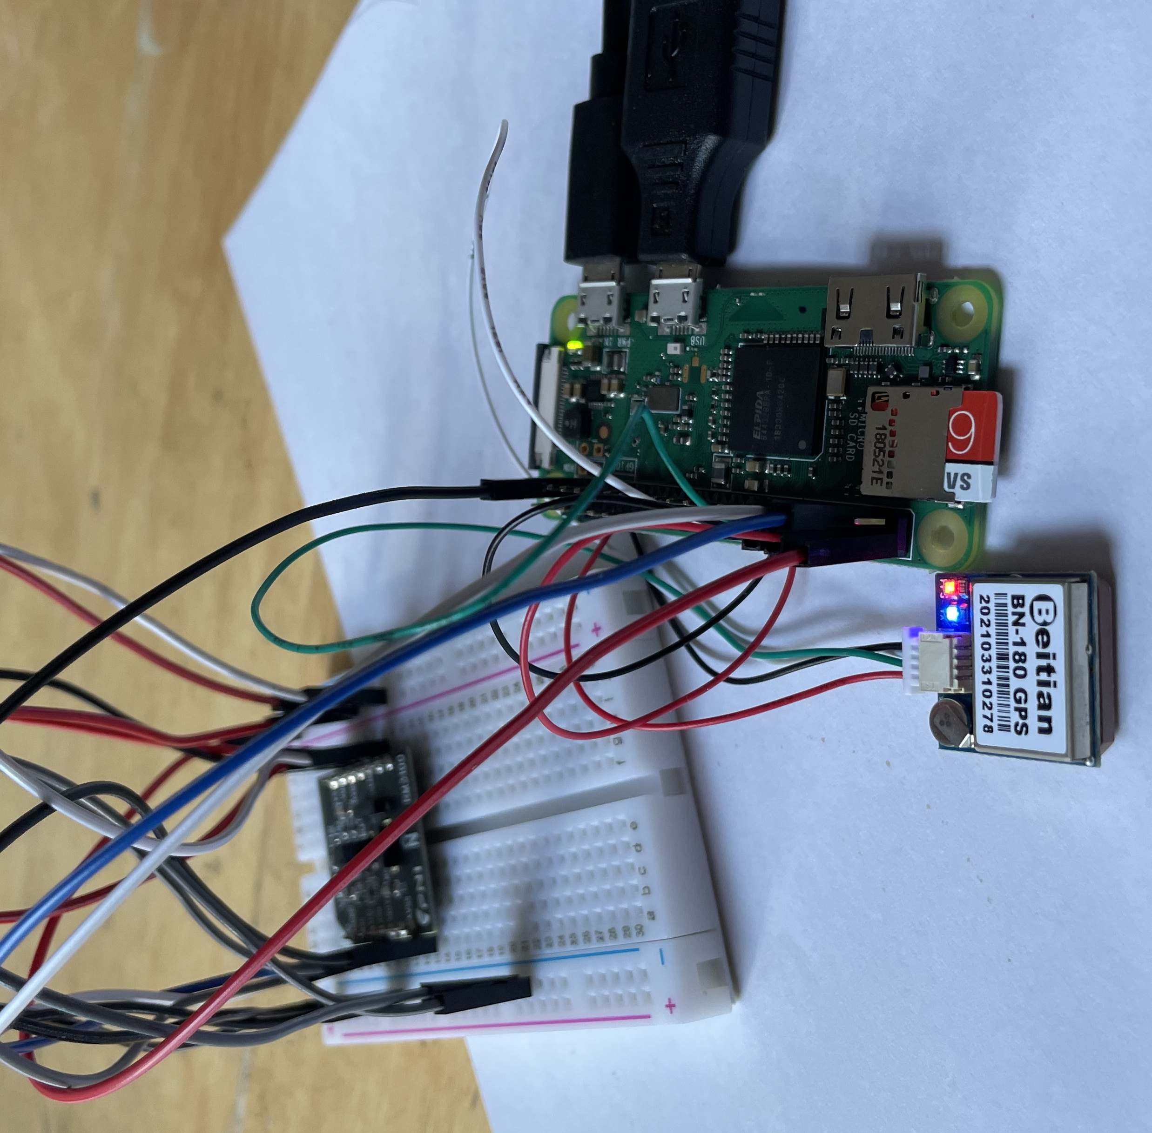
The EZIE mission reflects the timely convergence of a new compact sensor technology and the emergence of high-heritage CubeSats to provide insight into decade old mysteries surrounding the aurora
OUTREACH
Inputs
Activities
Outputs
Outcomes
Long-Term Benefits
20 institutional partners
APL communications resources
Existing NASA outreach infrastructure
EZIE subject-matter experts
Existing heliophysics data and NASA resources
EZIE data including SuperMAG Network
1000 MagPi kits with guides and videos
AR enhanced scale models of the EZIE spacecraft
NASA Space Apps Challenge
APL Central Spark events, APL summer camps, subject-matter expert sessions, workshops
Social media campaigns
Over 300,000 diverse participants will experience heliophysics-related STEM outreach through the EZIE activities.
The MagPi program will involve over 1000 indigenous outreach facilitators via existing APL and NASA networks.
Inspire diverse participants and involve them in heliophysics science events and resources
Provide a STEM path for underserved audiences
Increase experience and knowledge in outreach and communications among subject-matter experts
NASA STEM workforce grows more diverse/inclusive
NASA subject-matter experts effectively and efficiently engage in outreach through events and products
APL outreach fosters cross-cultural understanding and greater social equity

