Slide 1
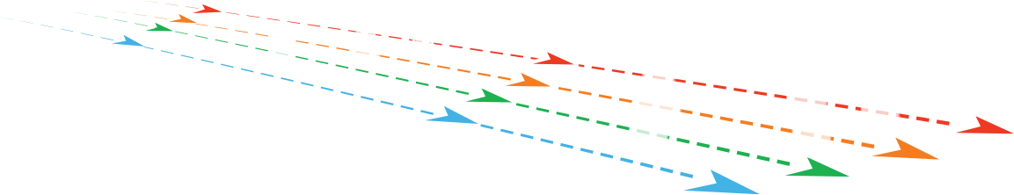
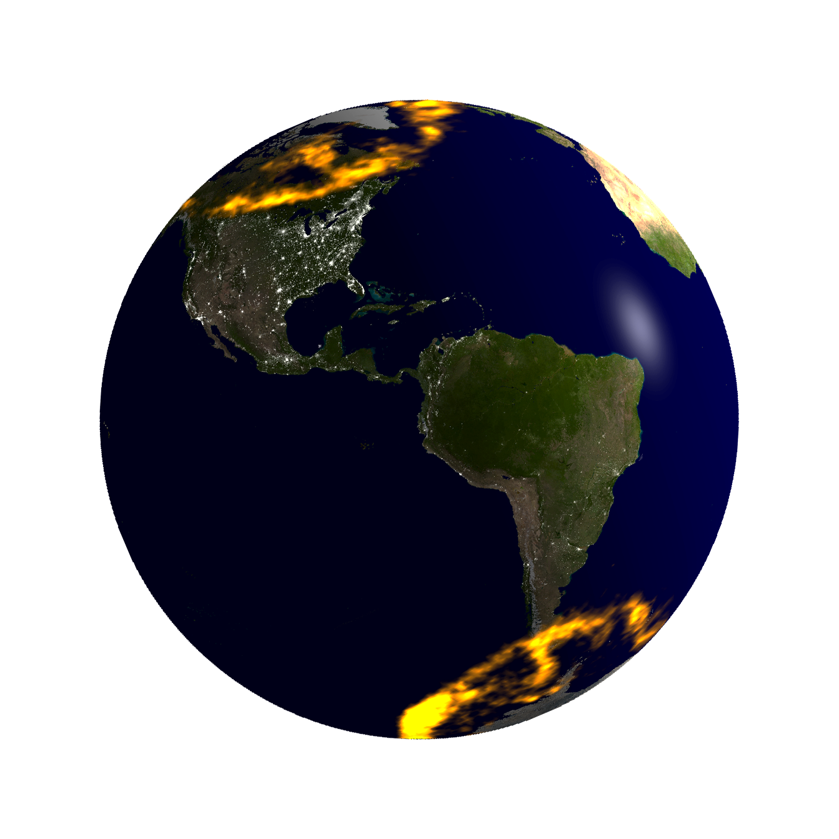
The EZIE mission reflects the timely convergence of a new compact sensor technology and the emergence of high-heritage CubeSats to provide insight into decade old mysteries surrounding the aurora
1
2
THE SCIENCE
3
What?
EZIE will image the magnetic signature of the ionospheric electrojets and reveal the underlying processes.
Electrojets are electrical currents related to the aurora.
How?
Three identical CubeSats will be deployed in a pearls-on-a-string, sun‐synchronous polar orbit.
Each CubeSat will provide four simultaneous remote sensing vector magnetic field measurements using the Zeeman splitting of the atmospheric O₂ thermal emissions.
Each orbit provides three maps of the electrojet current, one per CubeSat, to reveal spatial structure and temporal evolution.
Why?
EZIE will uncover physics required for better prediction
of space weather, which impacts our increasingly
technological society.
Science Questions
EZIE will test competing and much debated hypotheses regarding the current circuit linking Earth and near-space.
1
2
3
Auroral Electrojet, Question 1
Equatorial Electrojet
OR
OR
OR
Auroral Electrojet, Question 2
OR

Slide 2
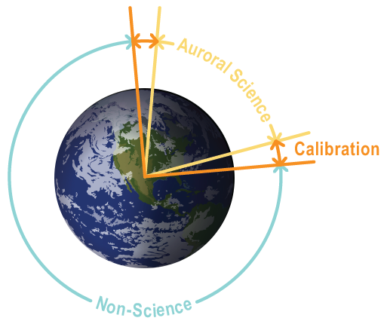
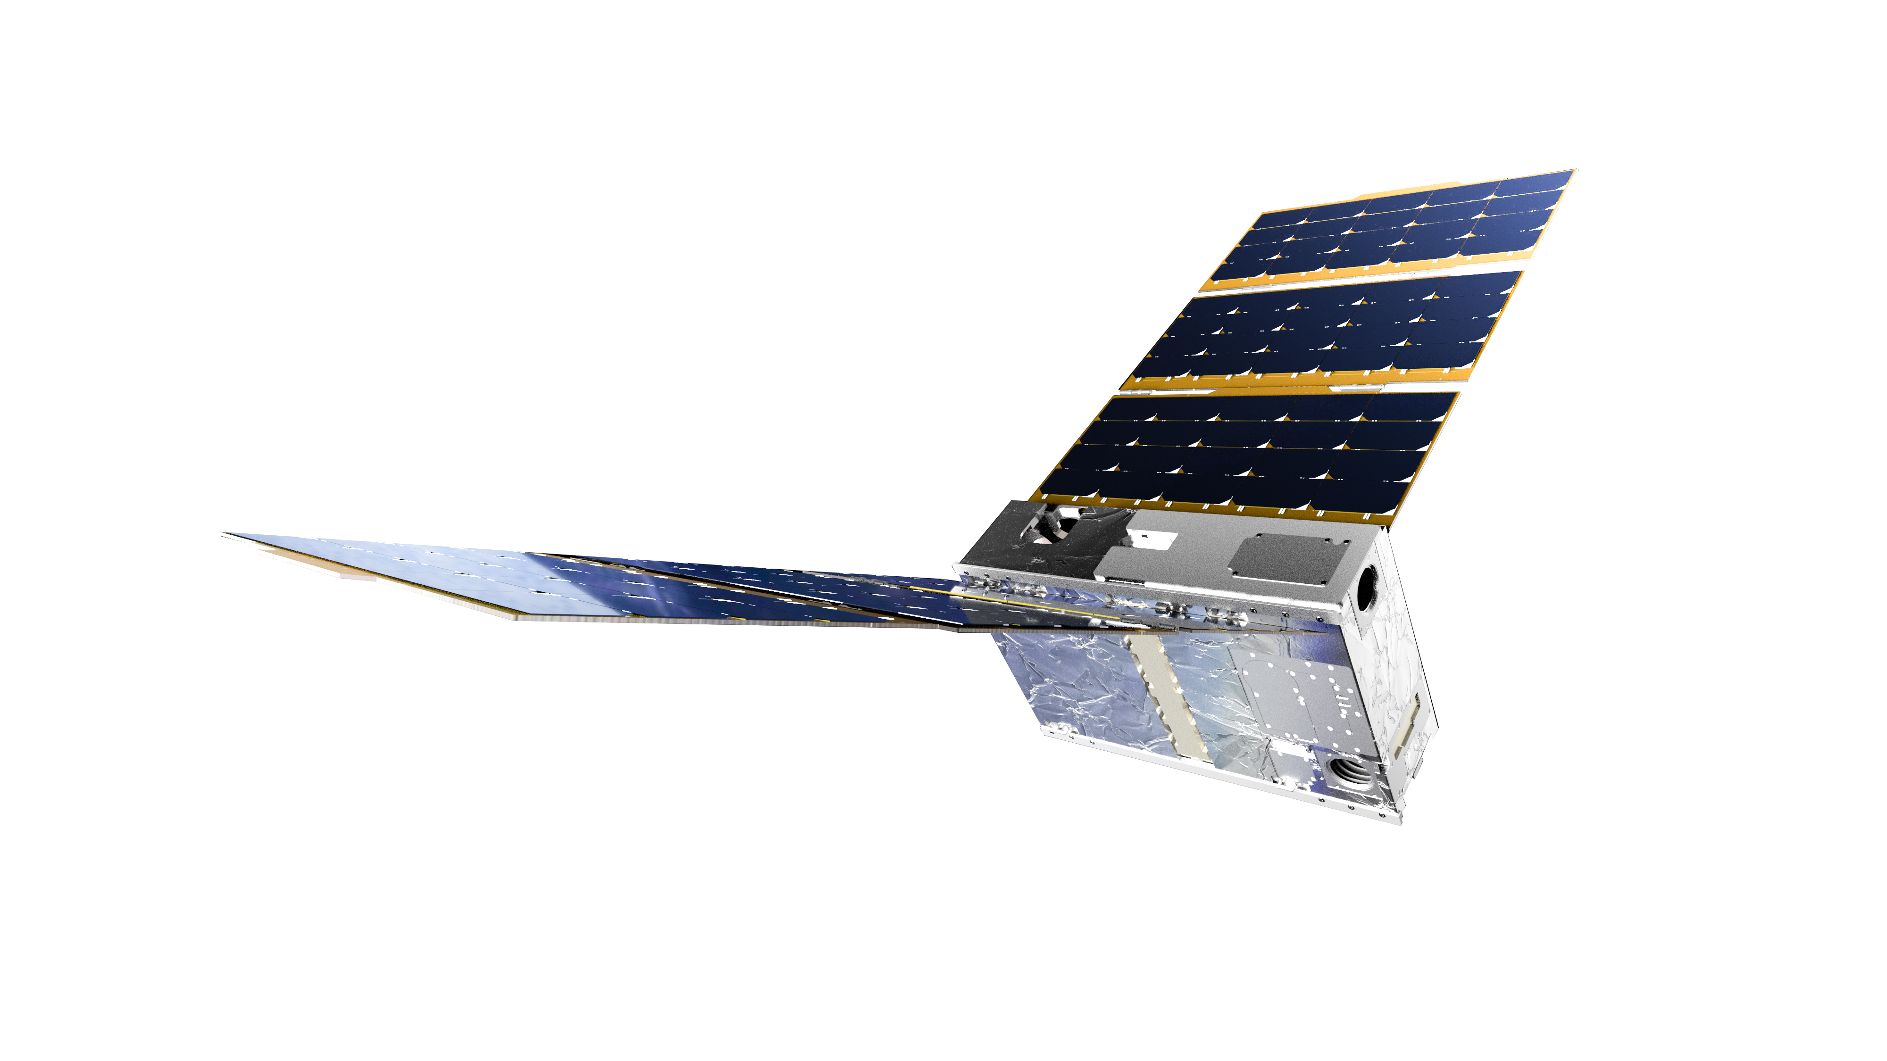
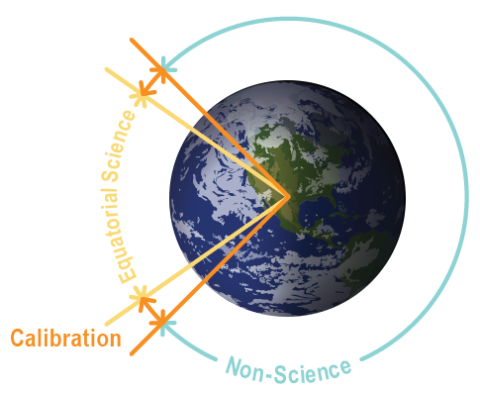
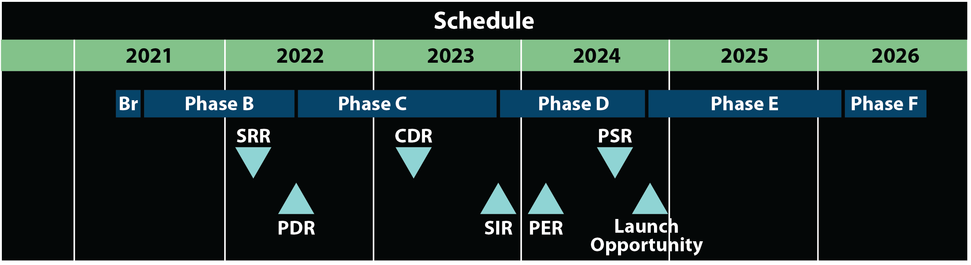
The EZIE mission reflects the timely convergence of a new compact sensor technology and the emergence of high-heritage CubeSats to provide insight into decade old mysteries surrounding the aurora
THE MISSION
Summer Season
At a Glance
Measurements of the structure and evolution of the ionospheric electrojets will resolve decades-old mysteries regarding the vast Earth–Space electrical current circuit.
Each CubeSat carries a compact Microwave Electrojet Magnetogram (MEM) instrument that uses the Zeeman effect to infer magnetic fields at ~80-km altitude, close to the source current.
Differential drag maneuver techniques demonstrated on past missions provide the desired along-track separation.
High-heritage designs will deliver a mission with high science impact at low cost and low risk.
Mission architecture provides high resilience to unplanned scenarios.
1.1 m & 12 kg mass
Equinox Season
6U-CubeSats have flight-proven performance from previous missions.
The MEM provides 4 simultaneous vector magnetic field measurements.
Each orbit has three modes:
Science (pointing nadir)
Calibration (pointing to cold space)
Non-Science (communications, drag, & charging)
Launching in fall 2024, EZIE has robust schedule reserves.

